Slide 1
Introduction to Natural Language Processing

Slide 2
What is Natural Language Processing?
● A field of computer science, artificial intelligence, and computational linguistics
● To get computers to perform useful tasks involving human languages
− Human-Machine communication
− Improving human-human communication
● E.g Machine Translation − Extracting information from texts

Slide 3
Why is NLP interesting?
● Languages involve many human activities − Reading, writing, speaking, listening
● Voice can be used as an user interface in many applications − Remote controls, virtual assistants like siri,...
● NLP is used to acquire insights from massive amount of textual data − E.g., hypotheses from medical, health reports
● NLP has many applications
● NLP is hard!

Slide 4
Why is NLP hard?
Highly ambiguous
Sentence I made her duck may have different meanings (from Jurafsky book)
− I cooked waterfowl for her.
− I cooked waterfowl belong to her.
− I created the (plaster?) duck she owns.
− I caused her to quickly lower her head or body.
− I waved my magic wand and turned her into undifferentiated waterfowl.

Slide 5

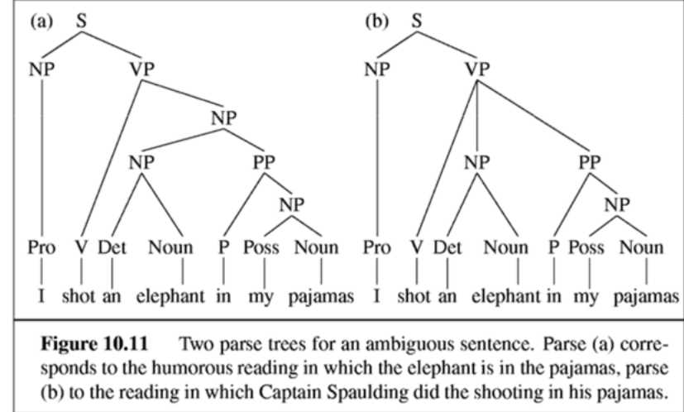
Why is NLP hard?
I shot an elephant in my pajamas.

Slide 6
Why is NLP hard
Natural languages are highly ambiguous at all levels
Lexical (word’s meaning)
Syntactic
Semantic
Discourse
Natural languages are fuzzy
Natural languages involve reasoning about the world − E.g., It is unlikely that an elephant wears a pajamas

Slide 7
Fundamental Tasks in NLP
● Word Segmentation
● Part-of-speech (POS) tagging
● Syntactic Analysis
● Semantic Analysis

Slide 8
Word Segmentation
● In some languages, there is no space between words, or a word may contain smaller syllables
− 毎年うちの研究室の学生が1-2名国語研でアルバイトさせ てもらっているので、今日は新しくアルバイトする B4 学 生の紹介である。
− Nhật Bản luôn là thị trường thương mại quan trọng của Việt Nam (Nhật_Bản luôn là thị_ trường thương_mại quan_trọng của Việt_Nam)
● In such languages, word segmentation is the first step of NLP systems.

Slide 9
Word Segmentation
● A possible solution is maximum matching
− Start by pointing at the beginning of a string, then choose the longest word in the the dictionary that matches the input at the current position.
− Nhật_Bản luôn là thị trường thương mại quan trọng của Việt Nam
● Nhật_Bản is a word in dictionary, but “Nhật Bản luôn” is not
● Problems: − Maxmatching could not deal with unknown words − Dependency between words in the same sentences is not exploited

Slide 10
Word Segmentation
● Most successful word segmentation tools are based on machine-learning techniques.
● Word segmentation tools obtained high accuracy
− vn.vitk (https://github.com/phuonglh/vn.vitk) obtained 97% accuracy on test data

Slide 11
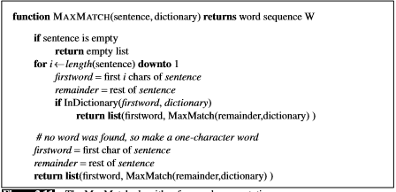

Slide 12
Does not work too well with English
Input: wecanonlyseeashortdistanceahead
Output: we canon l y see ash ort distance ahead

Slide 13
POS Tagging
● Each word in a sentence can be classified in to classes, such as verbs, adjectives, nouns, etc
● POS Tagging is a process of tagging words in a sentences to particular part-of-speech, based on:
− Its definition
− Its context in the sentence
● The/DT grand/JJ jury/NN commented/VBD on/IN a/DT number/NN of/IN other/JJ topics/NNS ./.

Slide 14
Sequence Labelling
● Many NLP problems can be viewed as sequence labeling
● Each token in a sequence is assigned a label.
● Labels of tokens are dependent on the labels of other tokens in the sequence, particularly their neighbors.
John saw the saw and decided to take it to the table. NNP VBD DT NN CC VBD TO VB PRP IN DT NN

Slide 15
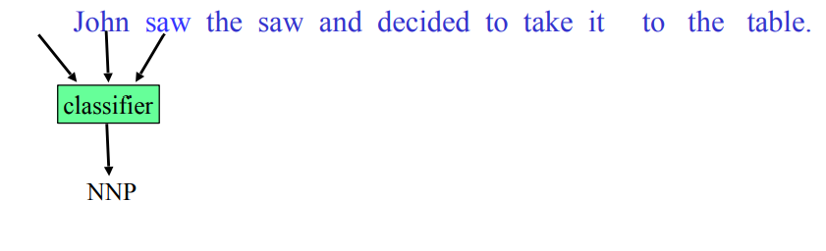
Sequence Labeling as Classification
Classify each token independently
Use as features, information about the surrounding tokens (sliding window). 18 John saw the saw and decided to take it to the table. classifier NNP

Slide 16
Probabilistic Sequence Models
• Model probabilities of pairs (token sequences, tag sequences) from annotated data set.
• Exploit dependency between tokens
• Typical sequence models
• Hidden Markov Models (HMMs)
• Conditional Random Fields (CRF)

Slide 17
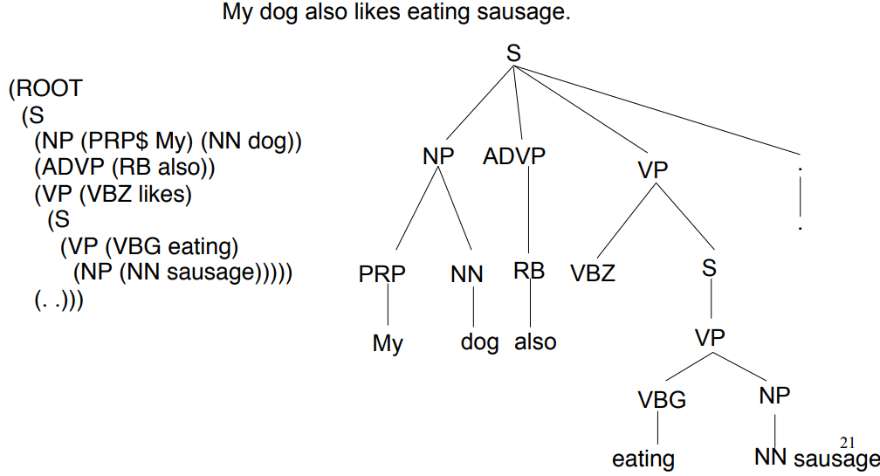
Syntax Analysis
● The task of recognizing a sentence and assigning a syntactic structure to it.

Slide 18
Syntax Analysis
An important task in NLP with many applications
− Intermediate stage of representation for semantic analysis
− Play an important role in applications like question answering and information extraction
− E.g., What books were written by British women authors before 1800?

Slide 19
Syntax Analysis
● A challenging task in NLP
− Ambiguity problem: one sentence may have many possible parsing trees
● Vietnamese language processing (VNLP) still lacks accurate syntax parsers (in my understanding)
− Accuracy about 78 ~ 84%

Slide 20
Approaches to Syntax analysis
● Top-down parsing
● Bottom-up parsing
● Dynamic programming methods
− CYK algorithm
− Earley algorithm
− Chart parsing
● Probabilistic Context-Free Grammars (PCFG)
● Assign probabilities for derivations

Slide 21
Semantic Analysis
● Two levels
● Lexical semantics
− Representing meaning of words
− Word sense disambiguation (e.g., word bank)
• Compositional semantics − How words combined to form a larger meaning.

Slide 22
Meaning Representation
• First order predicate calculus
•E.g., Maharani serves vegetarian food.
=> Serves(Maharani, vegetarian food)
•E.g., I only have five dollars and I don’t have a lot of time
=> Have(Speaker, FiveDollars) ∧ ¬Have(Speaker, LotOfTime)

Slide 23
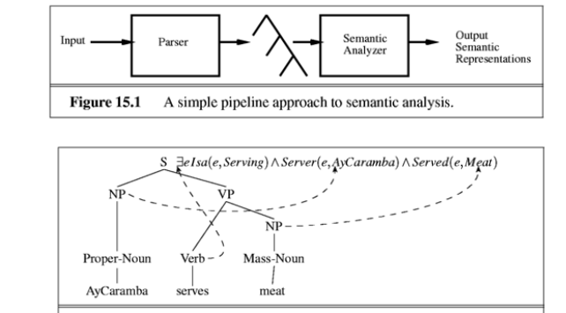
Syntax-driven semantic analysis

Slide 24
Some Applications
● Information Retrieval
● Information Extraction
● Question Answering
● Text Summarization
● Machine Translation

Slide 25
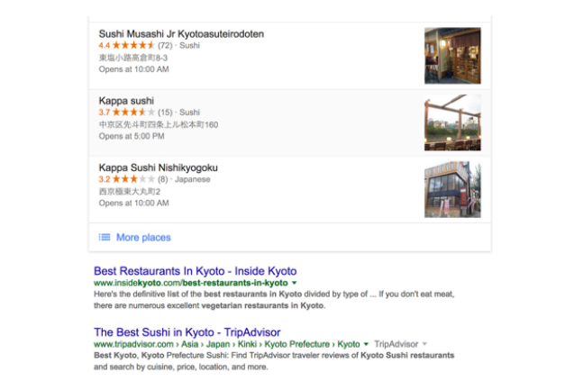
Information Retrieval
● Query: “list of good sushi restaurants in kyoto?”

Slide 26
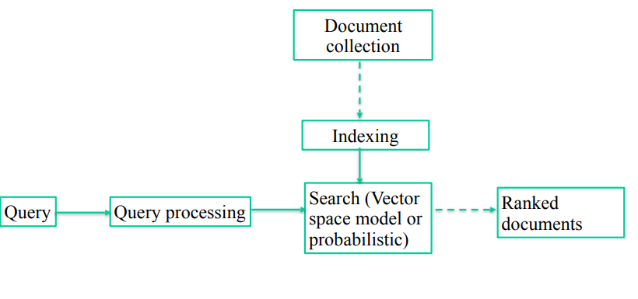
Architecture of an ad hoc IR system

Slide 27
Information Extraction
● To extract from unstructured text, information which pre-specified or pre-defined in templates
− Fill a number of slots/attributes
● Example: use template [PERSON, go, LOCATION, TIME] to extract information about the destination of an individual goes.
− “President Obama went to Hanoi yesterday.
− [PERSON = “President Obama”, go, LOCATION = “Hanoi”, TIME = “yesterday”]

Slide 28
Question Answering
● A system that automatically return answers for an user’s question by retrieving information from a collected documents.
● Differences from information retrieval system:
− QA system’s goal is to respond exact answer instead of documents related to users’ question.
● Q: who did invent the internet? A: Robert E. Kahn and Vint Cerf.
− QA system requires more complicated semantic analysis.

Slide 29
Question Answering
● Factoid question answering:
− Who/What/Where/When
− Answers are often phrases.
● Non-factoid question answering:
− Definition question
− How/Why − Answers may span multiple sentences (paragraph)

Slide 30
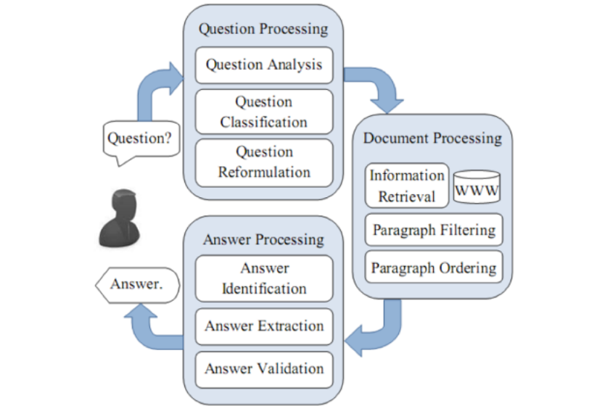

Slide 31
Text Summarization
● Text summarization is process of distilling the most important information from a text to produce an abridge version for a particular task or user.
● Useful in the era of information explosion
● Categories of text summarization:
− Single-document/Multi-document summarization
− Extractive/Abstractive summarization
− Query-focused text summarization

Slide 32
Machine Translation
● Text summarization is process of distilling the most important information from a text to produce an abridge version for a particular task or user.
● Useful in the era of information explosion
● Categories of text summarization:
− Single-document/Multi-document summarization
− Extractive/Abstractive summarization
− Query-focused text summarization

Slide 33
Example (Google translation)
It looked like the future: a wide, elevated Chinese bus that would speed atop tracks straddling the road while multiple lanes of traffic flowed below. And the future looked surprisingly near.
Nó trông giống như tương lai: một rộng, xe buýt cao Trung Quốc sẽ tăng tốc trên đường ray trải dài đường trong khi nhiều tuyến đường giao thông chảy bên dưới. Và tương lai có vẻ ngạc nhiên gần.

Slide 34
Approaches in Machine Translation
• Rule-based methods
• Transfer-based MT
• Interlingual MT
• Dictionary-based MT
• Statistical MT
• Example-based MT
• Hybrid MT

Slide 35
